Slide 1
Embedded System
An embedded system is a computer system, made from a combination of hardware and software that is used to perform a specific task.
It may or not be programmable, depending on the application.
Examples of embedded systems include washing machines, printers, automobiles, cameras, industrial machines etc.

Slide 2
It uses a Microcontroller/Microprocessor to perform a single job. It is a stand-alone device with no operating system.
Examples may be a washing machine, Music player, ATM, Vending machine, Data Logger etc.

Slide 3
Nowadays, Most of the devices run on the OS (Operating System).
So, what is the need for an OS?
The user needs smarter devices capable of doing multiple jobs in less time.
Supports enough memory to run multiple applications.
Reusable and Stable with more software updates

Slide 4
Embedded systems have a microcontroller which gets input from hardware like keypad, buttons.
Firmware is stored in read-only or flash memory and is small in size.
Embedded systems can have little memory and may or may not have keyboard and screen or any sensor and gives output through motor, display or any mechanical work.
These systems can have external memory also which store nonvolatile data.
External memory sometimes builds internal into the microcontroller

Slide 5
The microcontroller can be written in any programming
language like C language, assembly language or any complex language.
The program is loaded into the microcontroller.
A program written for the microcontroller of the calculator cannot work with microwave and vice versa.
Program instructions written for embedded systems are known as firmware.
Firmware is stored in read-only or flash memory and is small in size.
Embedded systems can have little memory and may or may not have keyboard and screen.

Slide 6
Embedded systems consume low power to run microcontroller.
They are also of small size in terms of other systems.
They have a low cost per unit because of low computing power.
It is difficult to program to embed systems and they use intelligent code to operate.
When engineers are given the project to design an embedded system then they are guided to make the cost-effective system and reducing the size of the system.
Embedded systems are usually made on a large scale so the consumers can get a low price product.
The architecture of large machinery is complex and difficult to make. So engineers face difficulty in controlling the accuracy and efficiency of the system.
The goal is to make application programs that are more in performance and error-free.

Slide 7
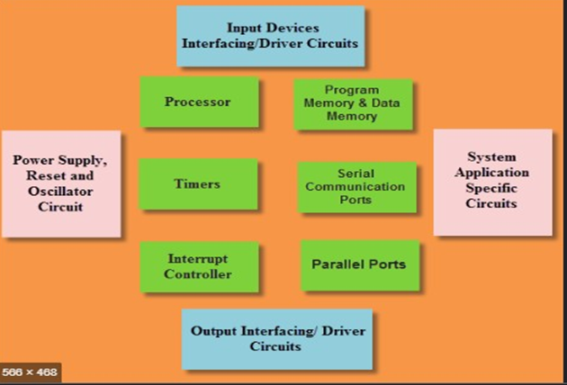
Fig. 1 Block Diagram of an Embedded System

Slide 8
Examples of Embedded System
Calculator
Calculator is also one of the examples of embedded systems.
Actually it is one of very earlier embedded system that is used widely.
In this example, the function is to take input from the keypad, perform the required operation and show the results on LCD.
Embedded Scientific Calculator has a high performance processor.
A number of mathematical complex calculations can be performed by these calculators.

Slide 9
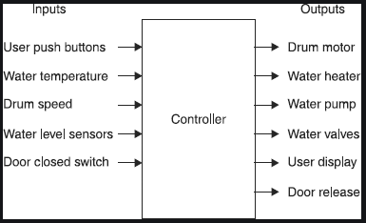
Fig.2 Inputs and outputs in an electronic washing machine

Slide 10
Daily life examples of embedded systems include automatic washing machines and dryers.
Washing clothes is not a difficult task now owing to embedded systems.
You just have to add clothes and leave it to the machine. Rest operations are done by your machine itself.
Machines have a Microcontroller for controlling all the tasks.
Sensors and actuators in this case are level sensors, valves, motor and also a display and keypad to input information.
Once you load clothes in machine, the whole process consists of three cycles. Washing, rinsing and spinning.
All the three cycles are initiated by machine itself. You just have to enter information for hot or cold water and press start button.
During washing and rinsing cycle, water is added to the drum by pipes.
Closing and opening of valves for adding water is checked through level sensors by microcontroller like PIC Microcontroller.
Then the rotation of drum starts for pre-set time. After that water is drained out through pipes.
During spinning cycle, water is not added and drum rotates for a set time.
All the processes are controlled by microcontroller program.
The timings for each cycle can be changed through the keypad.
So this was another embedded systems examples. Now let’s move towards the next one.

Slide 11
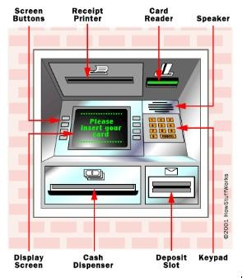
Automated Teller Machine (ATM

Slide 12
An automated teller machine (ATM) is also an embedded system.
It is a computerized device used in banking.
You all are already familiar with its operation and use.
A customer can access and perform his transactions without going to the bank and meeting some assistant.
This machine consists of a card reader for detecting card and accessing information of the person.
Also it has a keypad so the user can enter his commands and password.
A screen displays information. A printer prints the receipts and cash is received from cash dispenser.
A network is present between the bank computer and ATM machine through a host computer.
All the data is verified with the bank computer and all transactions are stored in it.
All these input and output operations are carried with the help of microcontroller.
So this makes a one of the best examples of Embedded Systems.

